Slide 1
Nissan Leaf Driving Simulation
Team 8 – Michael Mollica, Brett Harden, Gerardo Mateo, Ethan Powers, & Chase Colotta

Slide 2
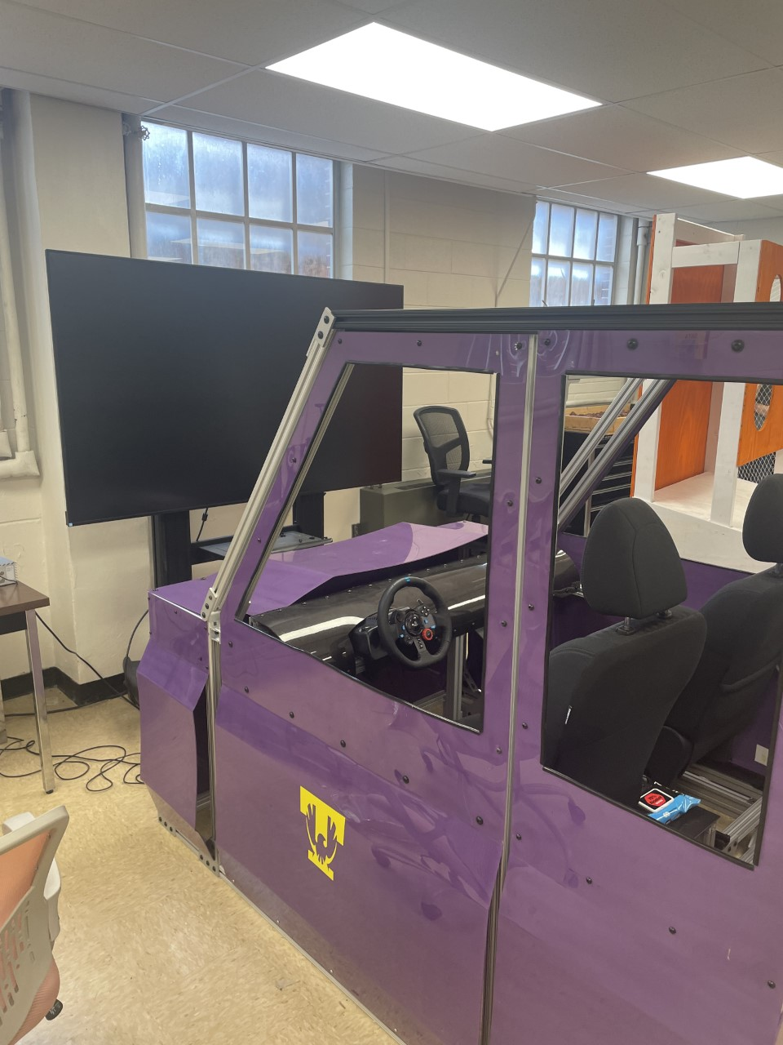
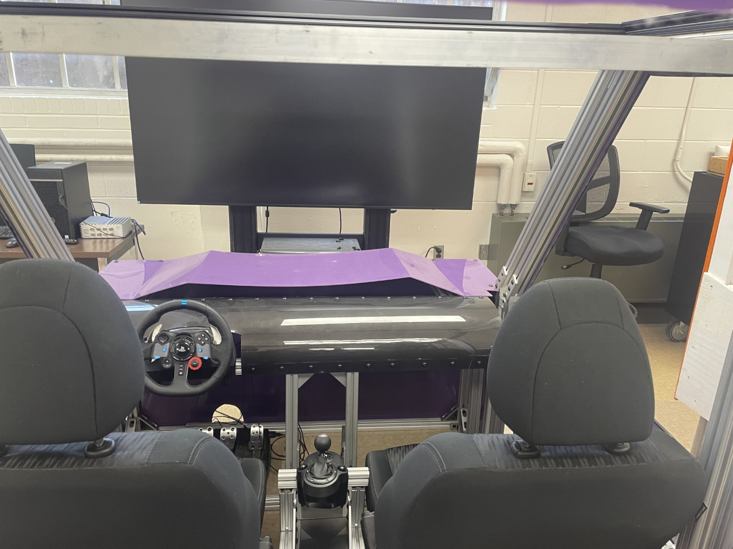
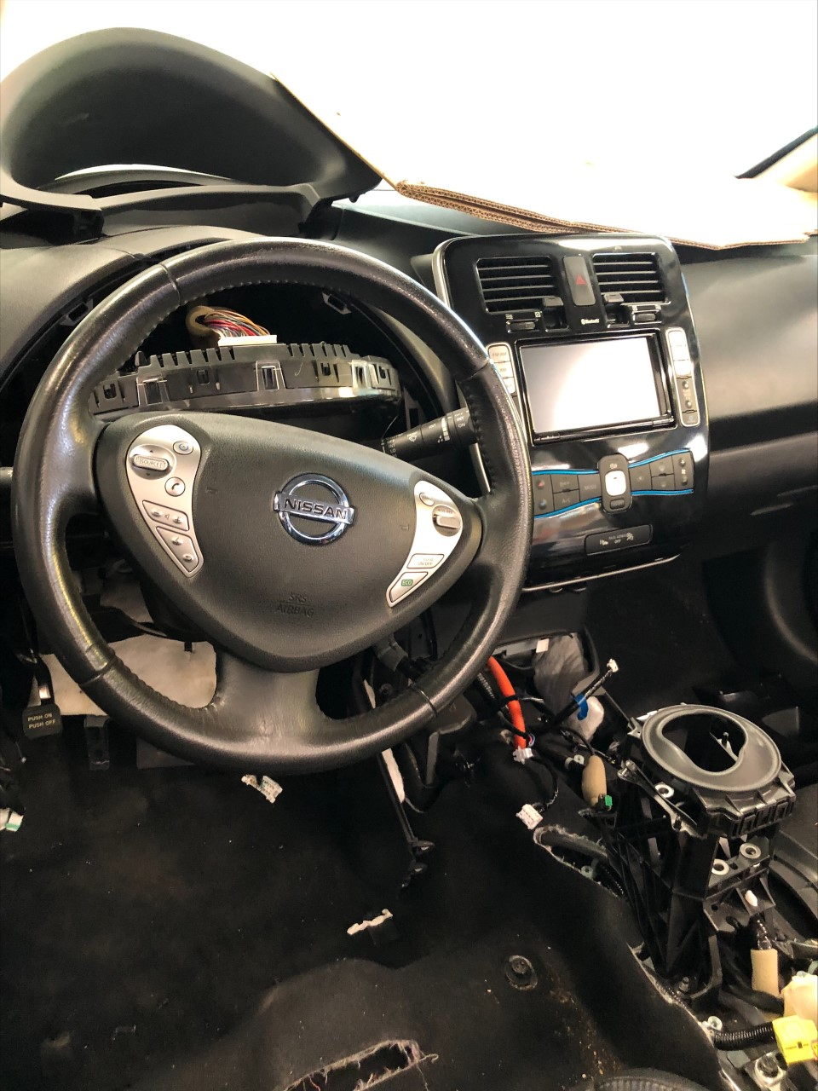
Mission Statement

Slide 3
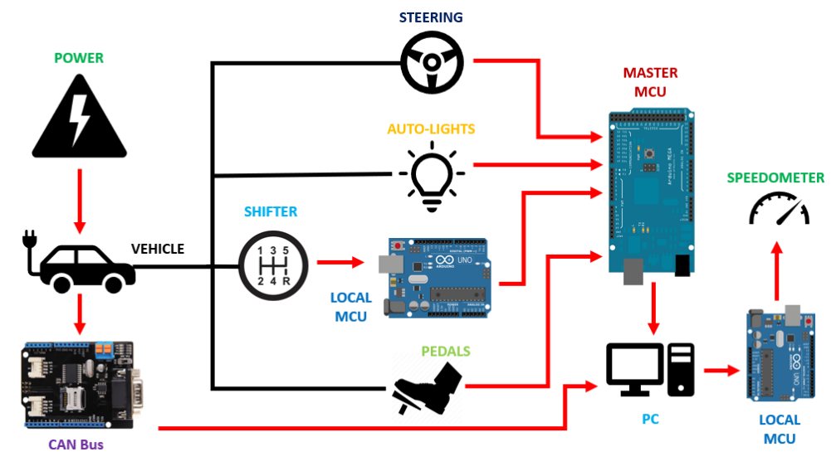

Slide 4
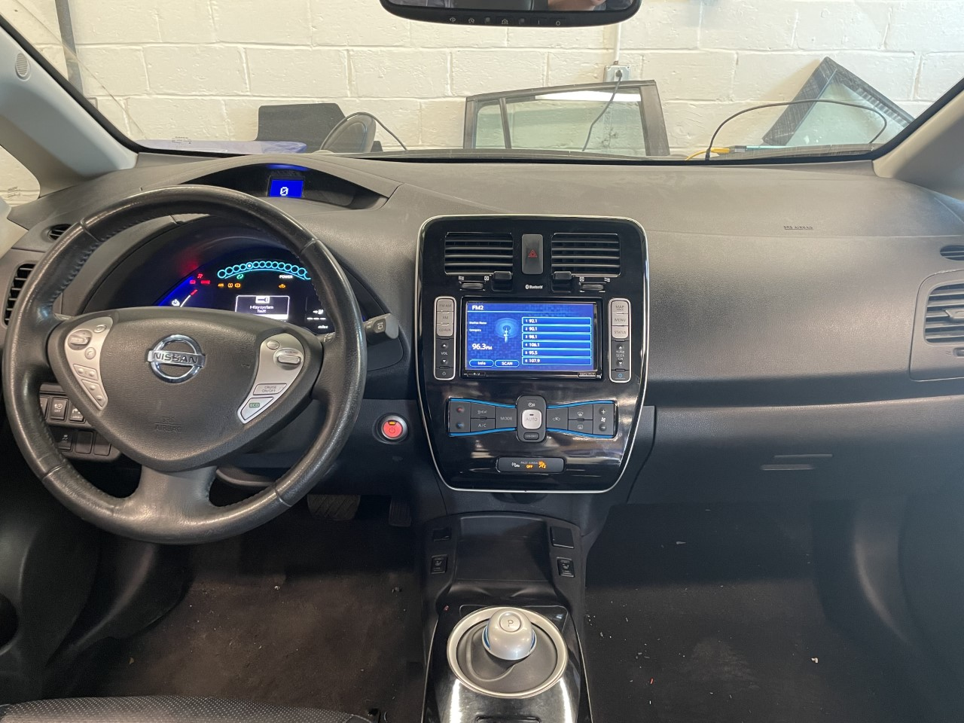

Slide 5
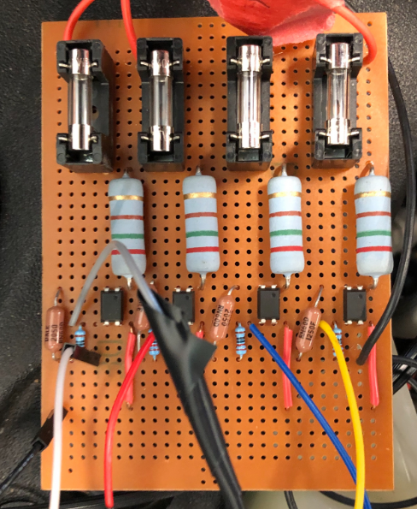
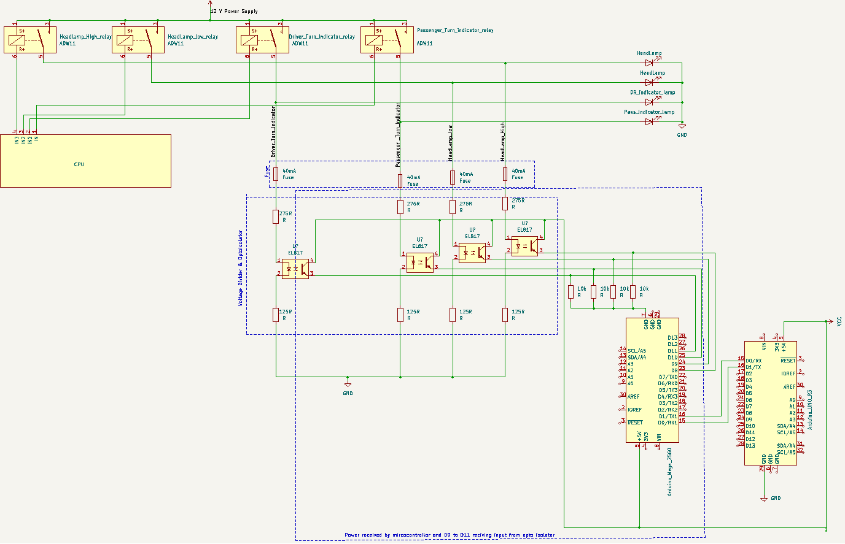
Auto-Light
Detect each auto-light setting → Low, High, Blinkers

Slide 6
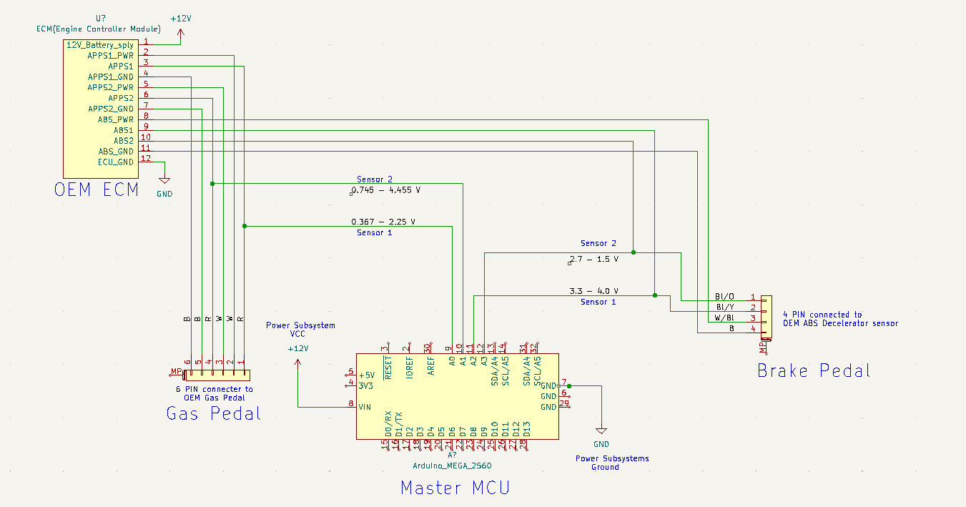
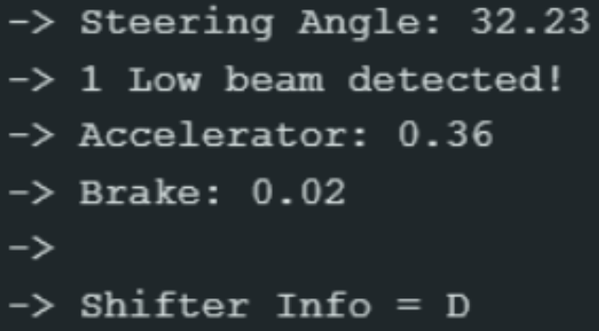
Accelerator & Brake
Must use OEM pedal sensors
IEEE std.576-13 → Wire Splicing

Slide 7
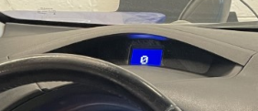
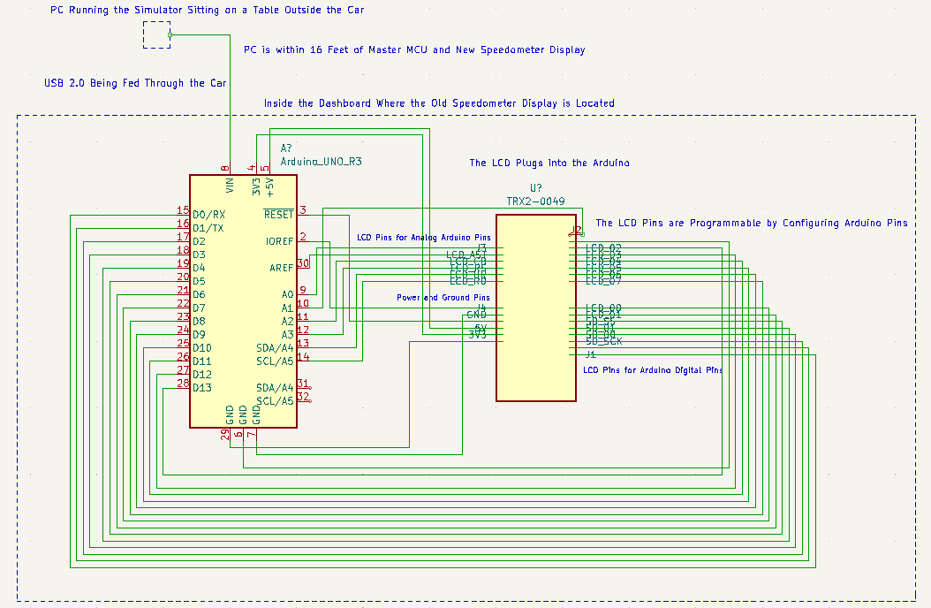
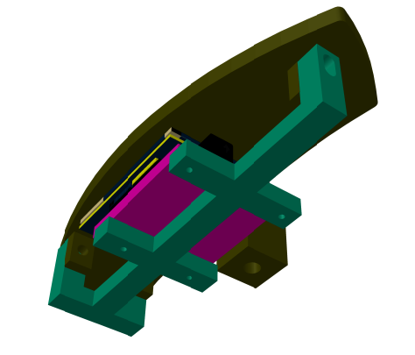
Speedometer
Display Simulink data to speedometer LCD

Slide 8
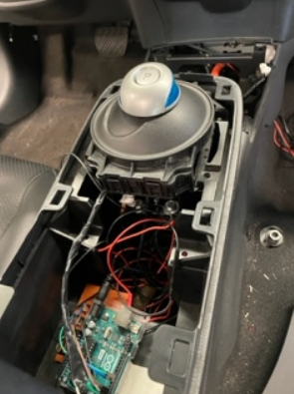
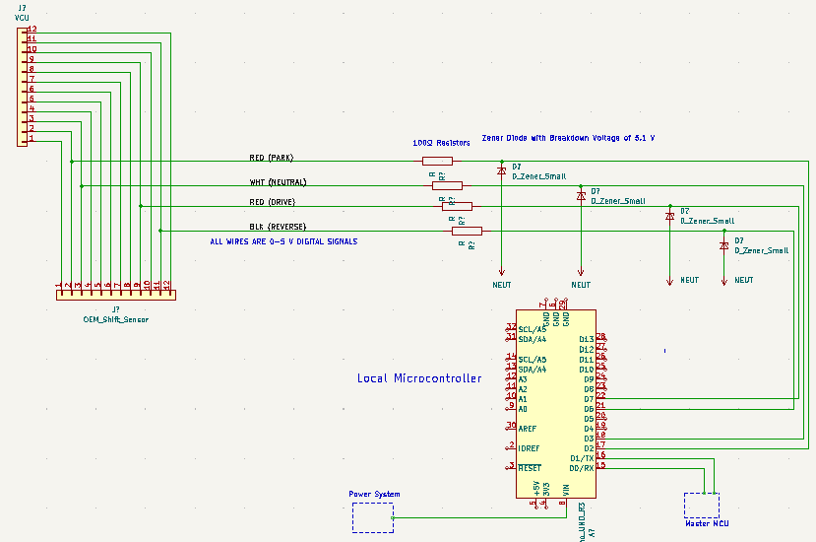
Shifter
Detect each shifter position → P, R, N, D

Slide 9
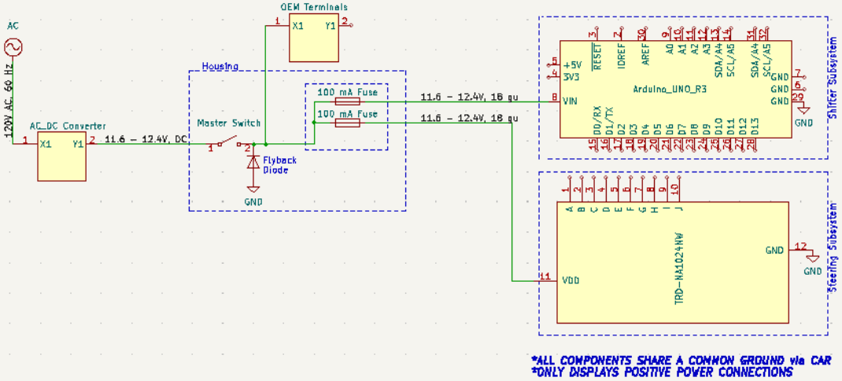
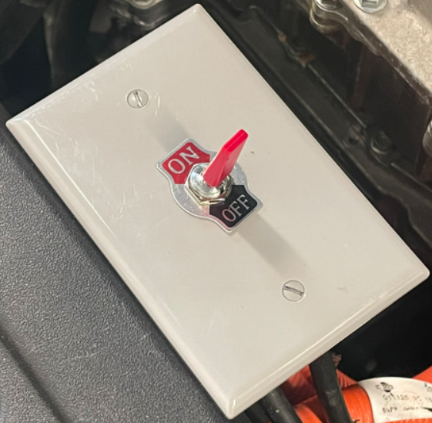
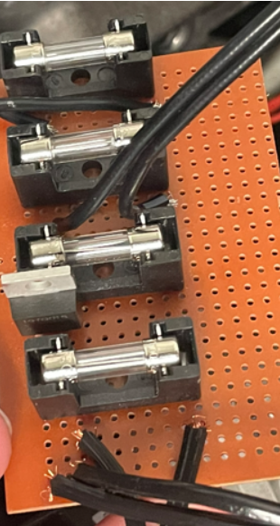
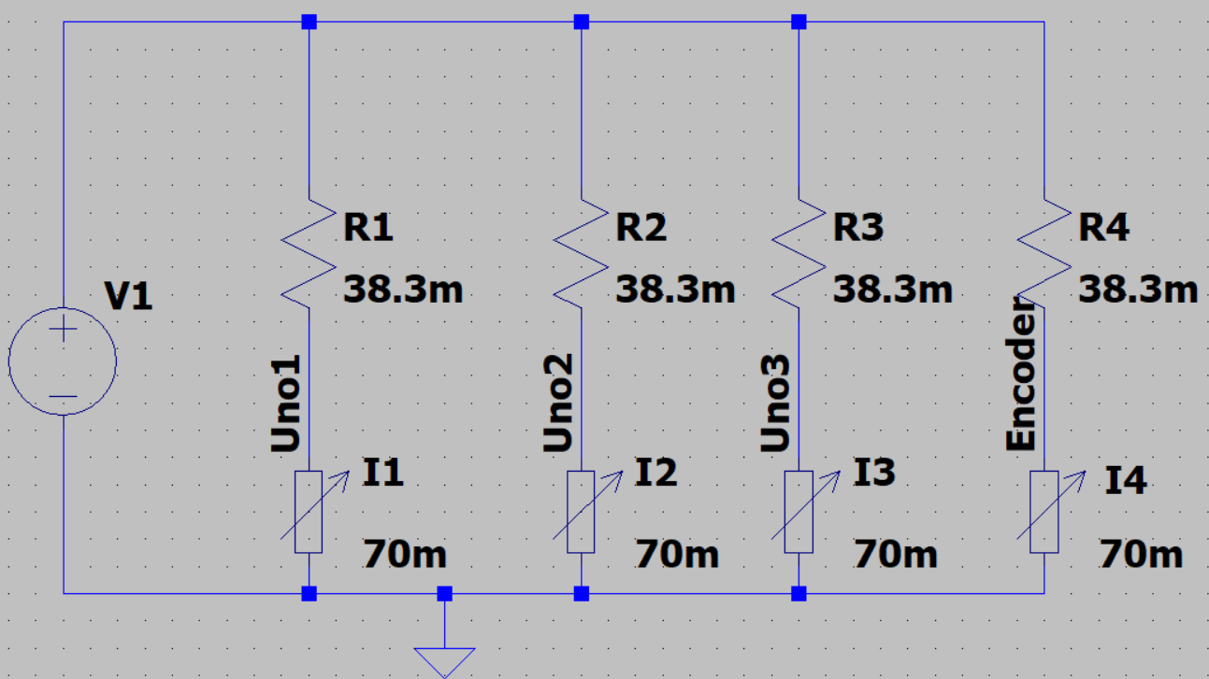
Power
Must regulate supplied source voltage to 12 V ± 5%

Slide 10
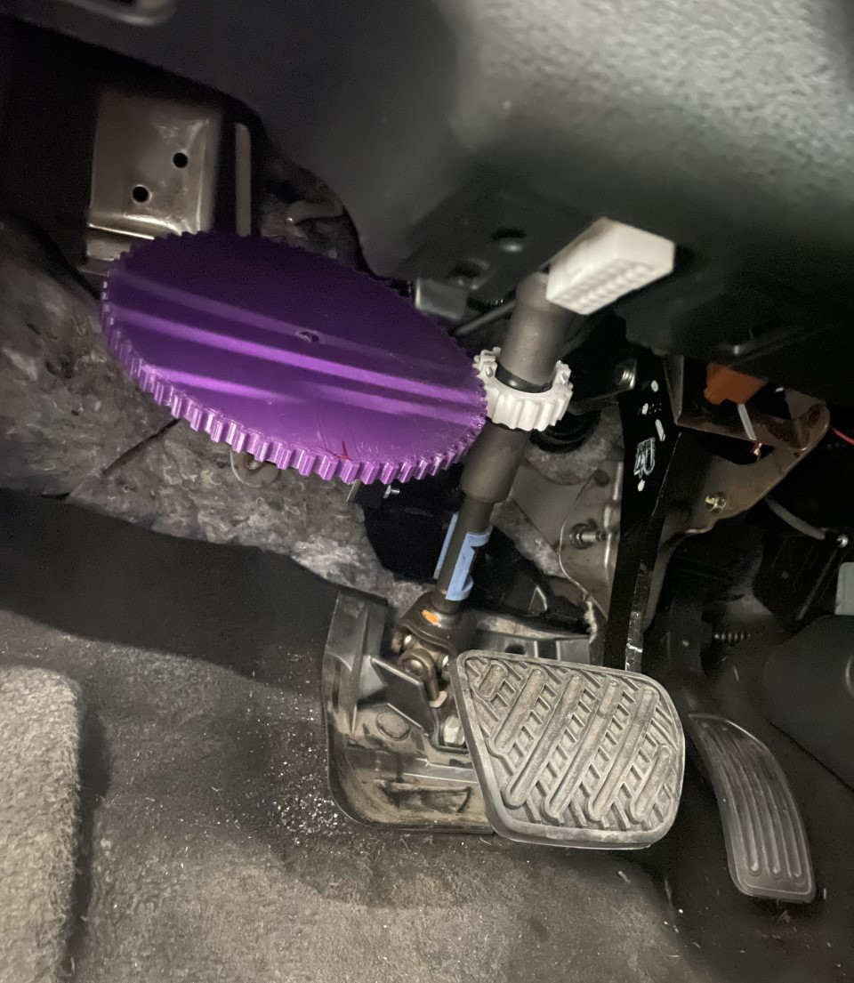
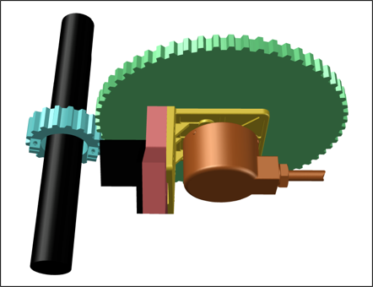
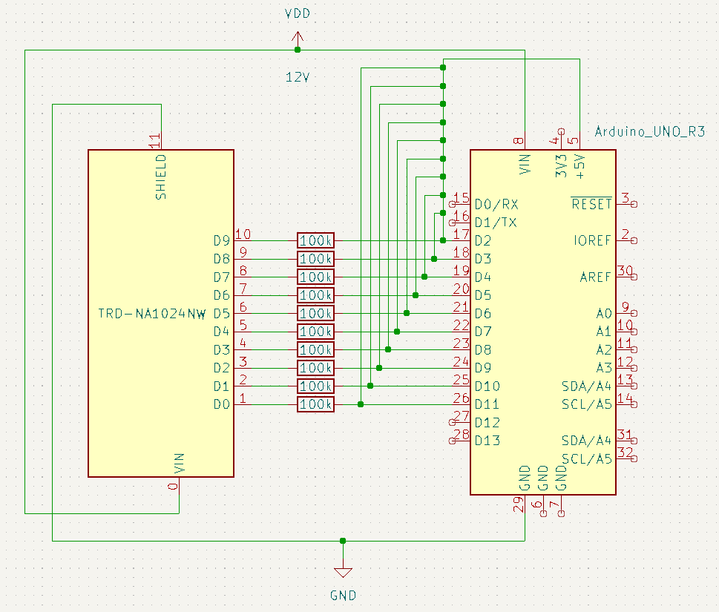
Steering
1200 degrees of rotation → 360-degree max
Left vs. Right

Slide 11
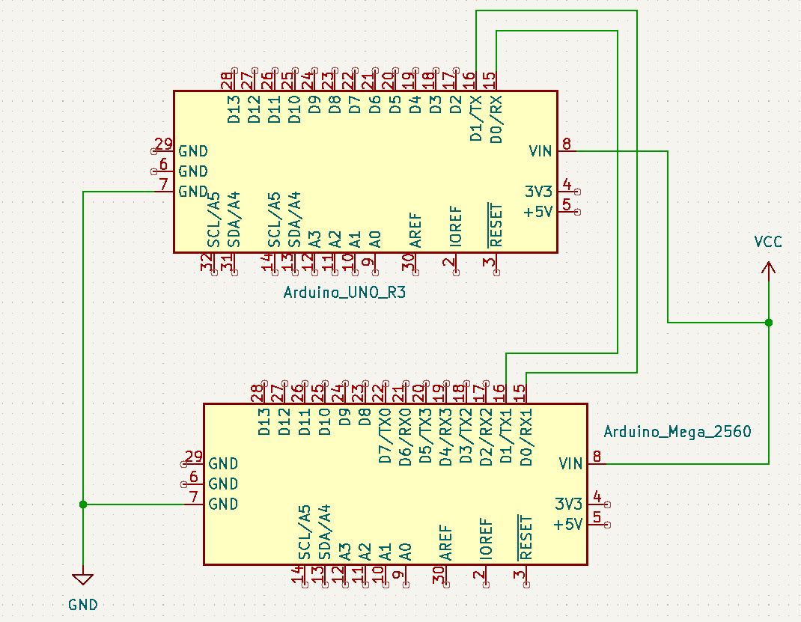
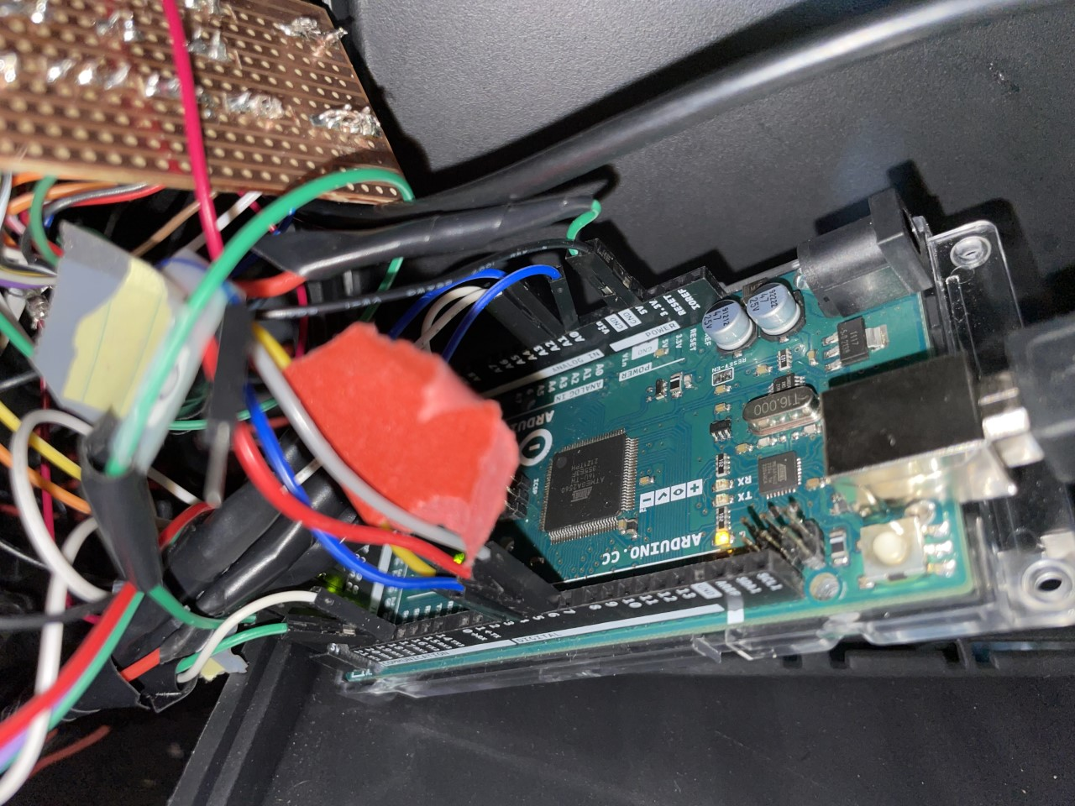
Master MCU
Real-time

Slide 12
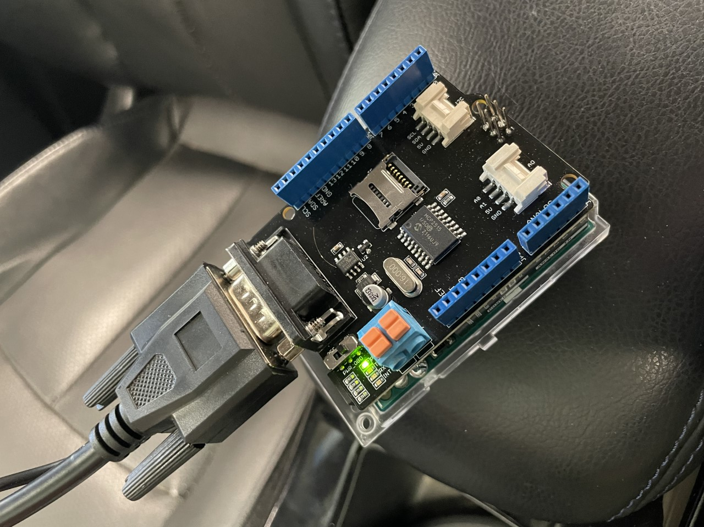
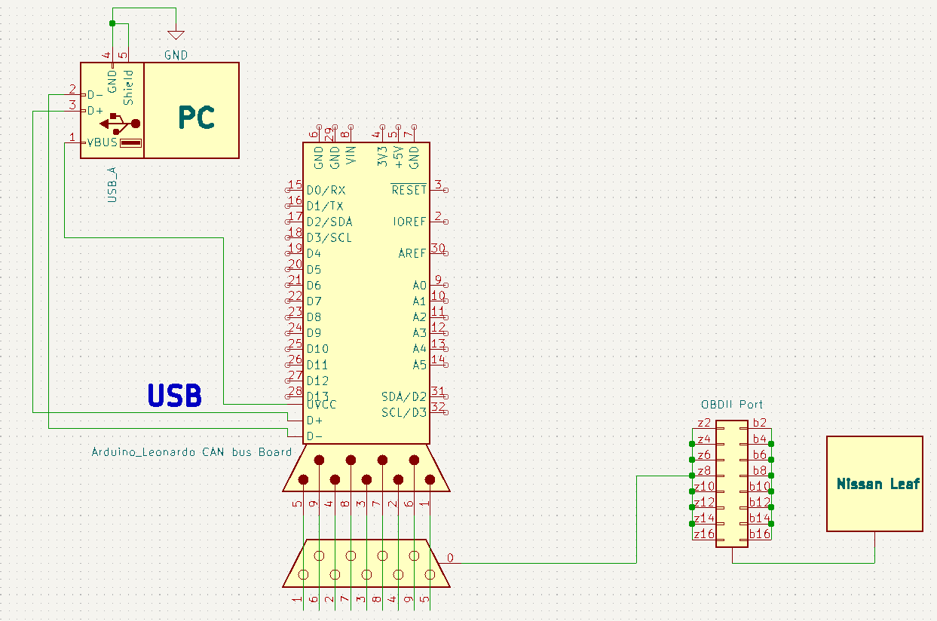
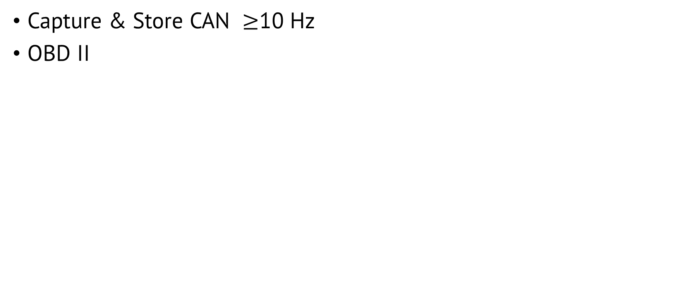
CAN Capturing
Capture & Store CAN $≥$10 Hz
OBD II
------------------------
Get data from ID: 0x2DE
0 0 0 0 0 0 FF FF
-----------------------------
Get data from ID: 0x260
C8 C8 FF F0
-----------------------------
Get data from ID: 0x5E3
FF FF FF F0 80
-----------------------------
Get data from ID: 0x2DE
0 0 0 0 0 0 FF FF
-----------------------------
Get data from ID: 0x180
0 0 0 0 0 0 2D 0
-----------------------------
Get data from ID: 0x355
0 0 FF FF 0 0 60 0
-----------------------------
Get data from ID: 0x2DE
0 0 0 0 0 0 FF FF
-----------------------------

Slide 13
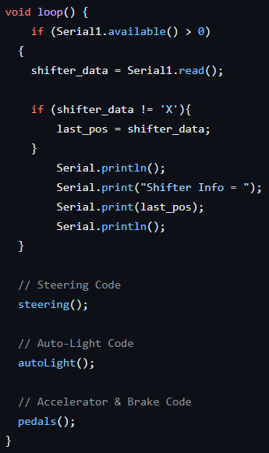
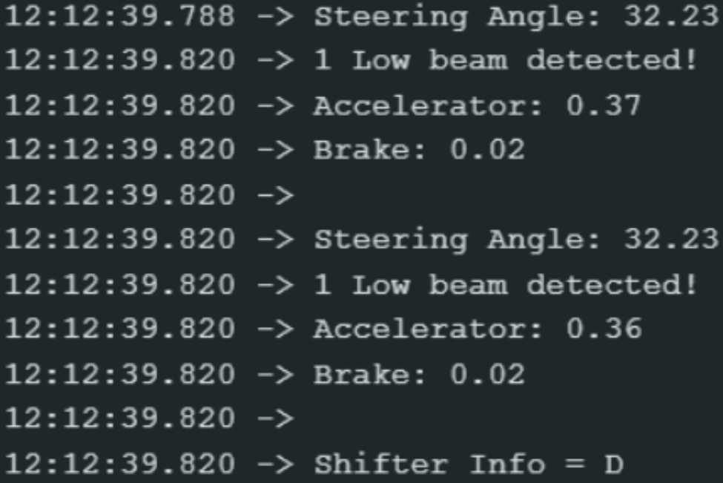
Software
Arduino
UART at 115200 baud rate

Slide 14
Experimentation & Validation
Equipment & Software includes:
Multimeter
Oscilloscope
Arduino IDE Timestamps
Simulink

Slide 15
Final Bill of Materials
$689.26
Product Name | Description | Subsystem | Part Number | Manufacturer | Qty | Price (each) | Item Totals
Rotary Encoder | The product is an absolute rotary incoder with a 6.5 ft output cable. | Steering | TRD-NA1024NWD | Koyo | 1 | $352.00 | $352.00
Mount | This is the right angle mounting bracket for the TRD-NA1024NWD | Steering | JT-035D | Koyo | 1 | $13.00 | $13.00
100k Ohm Resistor | These are the 100k Ohm resistors that will be used for voltage dividers | Steering | CFR25SJT-52-100K | Yageo | 25 | $0.05 | $1.25
Arduino Uno | MCU for reading Rotary encoder, reading shifter, | Steering, Shifter, Speedometer, Pedals | Arduino UNO Rev3 | Arduino | 4 | $27.60 | $110.40
Zener Diode | 5.1 V Zener Diode | Shifter | BZX79-C5V1 | Nexperia USA Inc | 10 | $0.16 | $1.60
100 Ω Resistor | 100 Ω Resistor | Shifter | LR1F | TE Connectivity Passive Product | 10 | $0.14 | $1.40
LCD Display | LCD Compatible with Arduino Uno | Speedometer | Treedix 3.5 inch TFT LCD Display | Treedix | 1 | $18.99 | $18.99
Toggle Switch | 12 V Toggle Switch | Power | TD1-1A-DC-3-R | Switch Components | 1 | $5.08 | $5.08
Standard Diode | Diode (Different fom signoff due to original being out of stock, higher ratings meet requirements) | Power | S-19TQ015-M3 | Vishay General Semiconductor - Diodes Division | 1 | $1.61 | $1.61
18 AWG wire | Wiring terminated to connect to Arduino | Power | 10-02493 | Tensility International Corp | 4 | $7.51 | $30.04
100 mA Fuse | 100 mA fuses to protect Arduinos | Power | 5ST 100-R | Bel Fuse Inc | 6 | $0.63 | $3.78
Fuse Holder | Hold 100 mA fuses | Power | 4628 | Keystone Electronics | 4 | $0.73 | $2.92
CAN-BUS Shield V2 | Arduino board to help capture CAN Bus messages | CAN | CAN-BUS Shield V2 | Seeed | 1 | $32.10 | $32.10
OBDII to DB9 Cable | Cable to connect the Arduino Board to the OBDII port of the Nissan Leaf | CAN | CAB-10087 | SparkFun Electronics | 1 | $10.95 | $10.95
Mega 2560 Rev3 | Microcontroller for the Master Microcontroller System | Master MCU | Mega 2560 Rev3 (Barcode: 7630049200067) | Arduino | 1 | $41.14 | $41.14
USB 2.0 Cable | USB cable for Arduino Mega 2560 | Master MCU | USB 2.0 Cable Type A/B | Arduino | 1 | $7.60 | $7.60
Optoisolator | OPTOISOLATR 5KV TRANSISTOR 4-DIP | OEM Lights | 160-1366-5-ND | Lite-On Inc | 10 | $0.24 | $2.40
250 Ohm Resistor | RES 250 OHM 5% 5W AXIAL | OEM Lights | 55J250E-ND | Ohmite | 5 | $1.06 | $5.30
125 Ohm Resistor | RES 125 OHM 1/4W 1% AXIAL | OEM Lights | RN60D1250FB14-ND | Vishay Dale | 5 | $0.70 | $3.50
40 mA Fuse | FUSE GLASS 40MA 250VAC 5X20MM | OEM Lights | 486-1876-ND | Schurter Inc | 6 | $2.67 | $16.02
Fuse Holder | FUSE HOLDER CART 250V 6.3A PCB | OEM Lights | RPC3981-ND | Essentra Components | 5 | $0.94 | $4.70
Wire Splices | Solderless wire splice connecters (package) | Pedals | B09539VNBK | XGTECH | 1 | $7.99 | $7.99
22 AWG | 22AWG wire 2 color 100ft | Pedals | B089D211KX | Fermerry | 1 | $15.49 | $15.49
 |  |  |  | Total Items | 105 | Total Price | $689.26

Slide 16
Final Display & Demonstration

